Slide 1
LIQUIDCRYSTALS
Dr. P. Venugopal

Slide 2
Contents:
-Introduction
-Classification
-Applications.

Slide 3
IMPORTANT TERMS
Positional order
Regularity in the distance between molecules
Orientational order:
Regularity in the orientation of molecules
Birefriegence: It is an optical property in which the material can propagate the polarized light with different speeds and different angles.

Slide 4
Anisotropic
Having properties which vary depending on the direction of measurement. Liquid crystals are anisotropic, due to the alignment and the shape of the molecules.
Isotropic
Having properties that are the same regardless of the direction of measurement. In the isotropic state, all directions are indistinguishable from each other. Like in liquids.

Slide 5
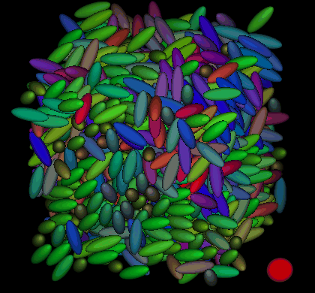
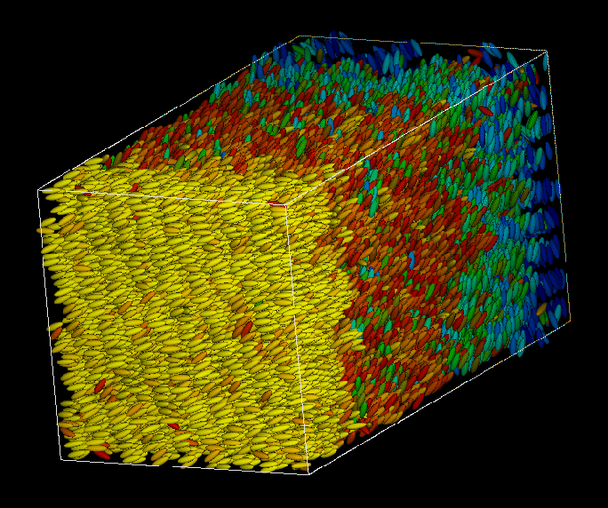
Isotropic
Liquids and gases
(uniform properties in all directions).
Anisotropic
Liquid Crystals
have orientational order
Notes:
Do not follow patterns, Some phases are combined and orientation is NOT the only way to characterize

Slide 6
Solid Phase
Molecules with both orientation and positional orders, and are held to each other strongly
Liquid Phase
Molecules with no orientation and positional orders, but are held together by weak intermolecular forces
Gas Phase
No ordering, no intermolecular attraction

Slide 7
-Apart from the three phases a number of intermediate phases present, in which one of the phases is Liquid crystal (Before reaching to the melting point of a substance)
It is defined as an order liquid fluid meso phase of an organic long chain molecule possessing both solid like order and liquid like character(mobility is less than isotropic liquids).
-Liquid crystals have both solid like order and liquid like fluid in a single phase with anisotropic provides unique interesting properties.

Slide 8
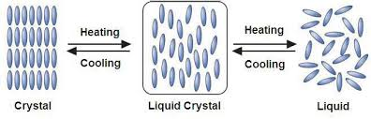

Slide 9
Conditions required to exhibit liquid crystalline behavior:
-Long chain molecule
-Rigidity
-Permanent dipole moment
-Presence of hydrophilic and hydrophobic groups.

Slide 10
IMPORTANT TERMS IN LIQUID CRYSTALS.
Lyotropic
Materials in which liquid crystalline properties appear induced by the presence of a solvent, with mesophases depending on solvent concentration, as well as temperature.
Thermotropic
Liquid crystal molecules which exhibit temperature dependent liquid crystalline behavior.
Director
The molecular direction of preferred orientation in liquid crystalline mesophases.

Slide 11
Classification of liquid crystals:
These are classified in to three types, based on how liquid crystalline state is produced in molecules.
1)Thermotropic liquid crystals-As the temperature changes leads to formation of these liquid crystals.
2) Lyotropic liquid crystals-Interaction between solute and solvent leads to formation of these liquid crystals.
3) Metallotropic liquid crystals: Interaction between organic and inorganic molecules leads to formation of these liquid crystals.

Slide 12

Chemical constitution and liquid crystalline behavior: Majority of organic compounds do show liquid crystalline behavior due to the presence of linkage groups and terminal substituent groups in the molecules. Thermotropic liquid crystals general chemical composition

Slide 13
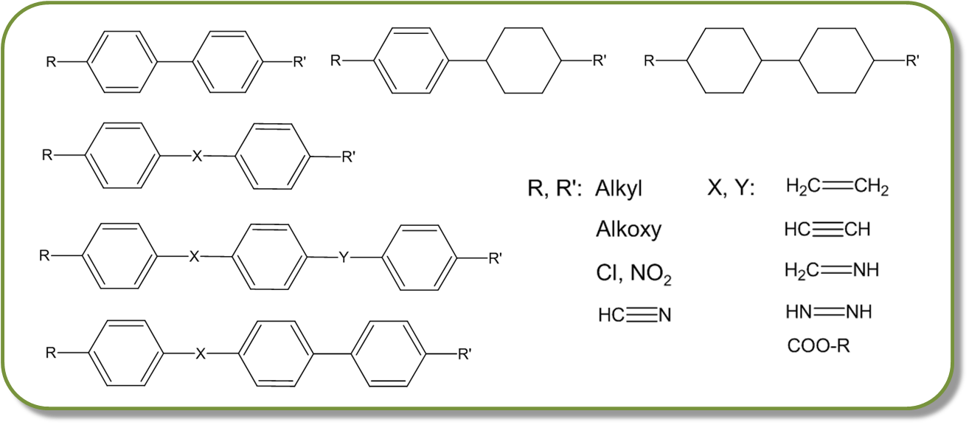

Slide 14
In the above fig,
First molecule is (If R= methoxy and R(prime) is Cyano then the molecule) known as para methoxy para cyano bi phenyl

Slide 15

In lyotropic liquid crystals one part of the molecule is hydrophilic means highly soluble in water and another portion is lipophilic means highly soluble in hydrocarbon solvent. Hydrophilic groups:--OH,-COOH,-COONa,-SO3, PO₄⁻³, Etc. Lipophilic groups: long chain hydrocarbons, with or without aromatic rings.

Slide 16
As the temperature changes ordering of molecules changes, as a result there is change in optical properties of thermotropic liquid crystals. Based on molecular order thermotropic liquid crystals are classified into-
Nematic,
Smectic and
Cholesteric liquid crystals

Slide 17
1.Nematic liquid crystals:
-Liquid crystals are characterized by molecules possessing only orientational but no positional long-range order.
-These liquid crystals exhibit normal liquid flow characteristics having low viscosity, turbid and anisotropic.
-Nematic phases are composed of rod-shaped molecular aggregates and molecules are aligned approximately parallel to each other to a principle axis n.
-When they observed through polarized light they appear as thread like, hence these are also known as thread like liquid crystals.-They exhibit birefriengene property.
-There is no Bragg peaks in XRD spectrum
Example- para methoxy cinnamic acid

Slide 18
2. Smectic liquid crystals:
The word "Smectic" is derived from the Greek word for soap. The thick, slippery substance often found at the bottom of a soap dish is a type of Smectic liquid crystal.
The Smectic state is another distinct mesophase of liquid crystal substances. Molecules in this phase show a degree of translational order(Positional order) not present in the Nematic. In the Smectic state, the molecules maintain the general orientational order of Nematic, but also tend to align themselves in layers or planes.

Slide 19
Motion is restricted to within these planes, and separate planes are observed to flow past each other. The increased order means that the Smectic state is more "solid-like" than the Nematic.
Many compounds are observed to form more than one type of Smectic phase. Till Now 12 different Smectic phases have been identified.

Slide 20
3. Cholesteric liquid crystals:
These are also known as Chiral Nematic. Similar to the Nematic phase, however, in the cholesteric phase, molecules in the different layers orient at a slight angle relative to each other (rather than parallel as in the Nematic). Each consecutive molecule is rotated slightly relative to the one before it. Therefore, instead of the constant director of the Nematic, the cholesteric director rotates helically throughout the sample. Many cholesterol esters exhibit this phase hence they are named as cholesteric liquid crystals.

Slide 21
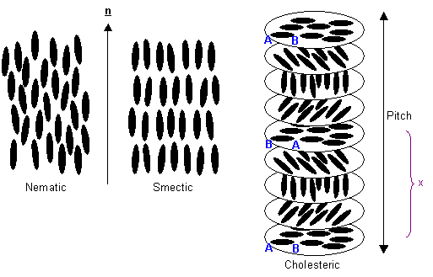

Slide 22
Applications of Liquid Crystals
Liquid crystal technology has a major effect many areas of science and engineering, as well as in device technology.
1. Liquid Crystal Displays
The most common application of liquid crystal technology is liquid crystal displays (LCDs.) this field has grown into a multi-billion-dollar industry, and many significant scientific and engineering discoveries have been made.
2. Liquid crystal thermometres.
Chiral nematic (cholesteric) liquid crystals reflect light with a wavelength equal to the pitch. Because the pitch is dependent upon temperature, the color reflected also is dependent upon temperature. Liquid crystals make it possible to accurately gauge temperature just by looking at the color of the thermometer. By mixing different compounds, a device for practically any temperature range can be built.

Slide 23
3. Optical Imaging (to identify the tumors in diagnosis)
Liquid crystals are being explored for optical imaging and recording. In this technology, a liquid crystal cell is placed between two layers of photoconductor. Light is applied to the photoconductor, which increases the material's conductivity. This causes an electric field to develop in the liquid crystal corresponding to the intensity of the light. The electric pattern can be transmitted by an electrode, which enables the image to be recorded. This technology is still being developed and is one of the most promising areas of liquid crystal research in biomedical engineering field.
.

Slide 24
4. Liquid crystal solar cell
A new and promising application using liquid crystals is the liquid crystal semiconductor. Liquid crystals are organic molecules like polymers. In polymers containing conjugated systems (alternating single and double bond) the creation of a higher and lower pi-bond leads to the creation of a band gap like semiconductors. The use of such a liquid crystal in a device like the photo voltaic cell.

Slide 25
5. Other Liquid Crystal Applications
They are used for nondestructive mechanical testing of materials under stress. This technique is also used for the visualization of RF (radio frequency) waves in waveguides.
They are used in medical applications where, for example, transient pressure transmitted by a walking foot on the ground is measured.
Low molar mass (LMM) liquid crystals have applications including erasable optical disks, full color "electronic slides" for computer-aided drawing (CAD), and light modulators for color electronic imaging.

